Slide 1
XPC
(Express Pedestrian Crossing)
Port of Entry
20
22
CaliBaja Region
Zack Defazio Farrell
20
22

Slide 2
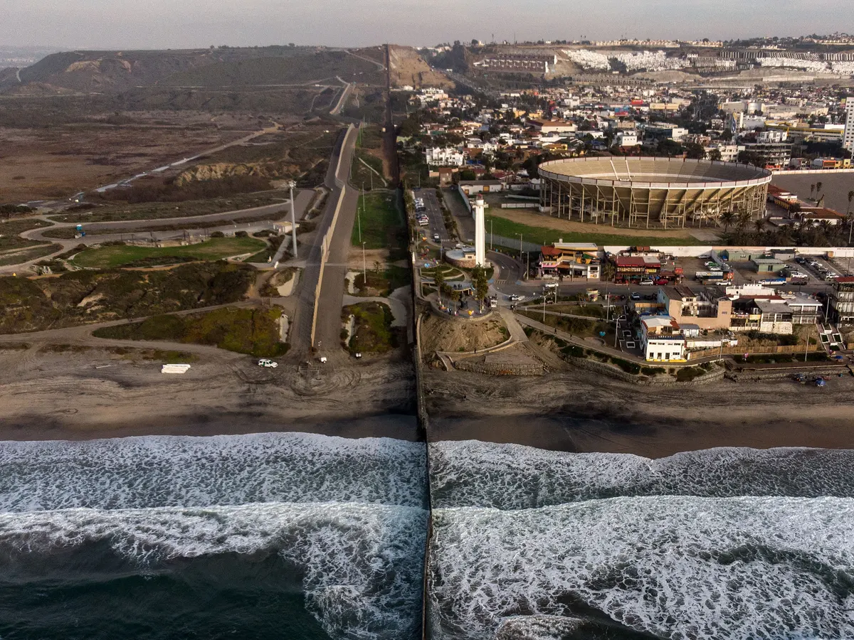
Statement of Issue
7 million inhabitants
$250 billion economy
120,000 personal vehicles and 63,000 pedestrians cross daily
Long lines and delays cost $3.4 billion in lost revenue and 88,000 jobs

Slide 3
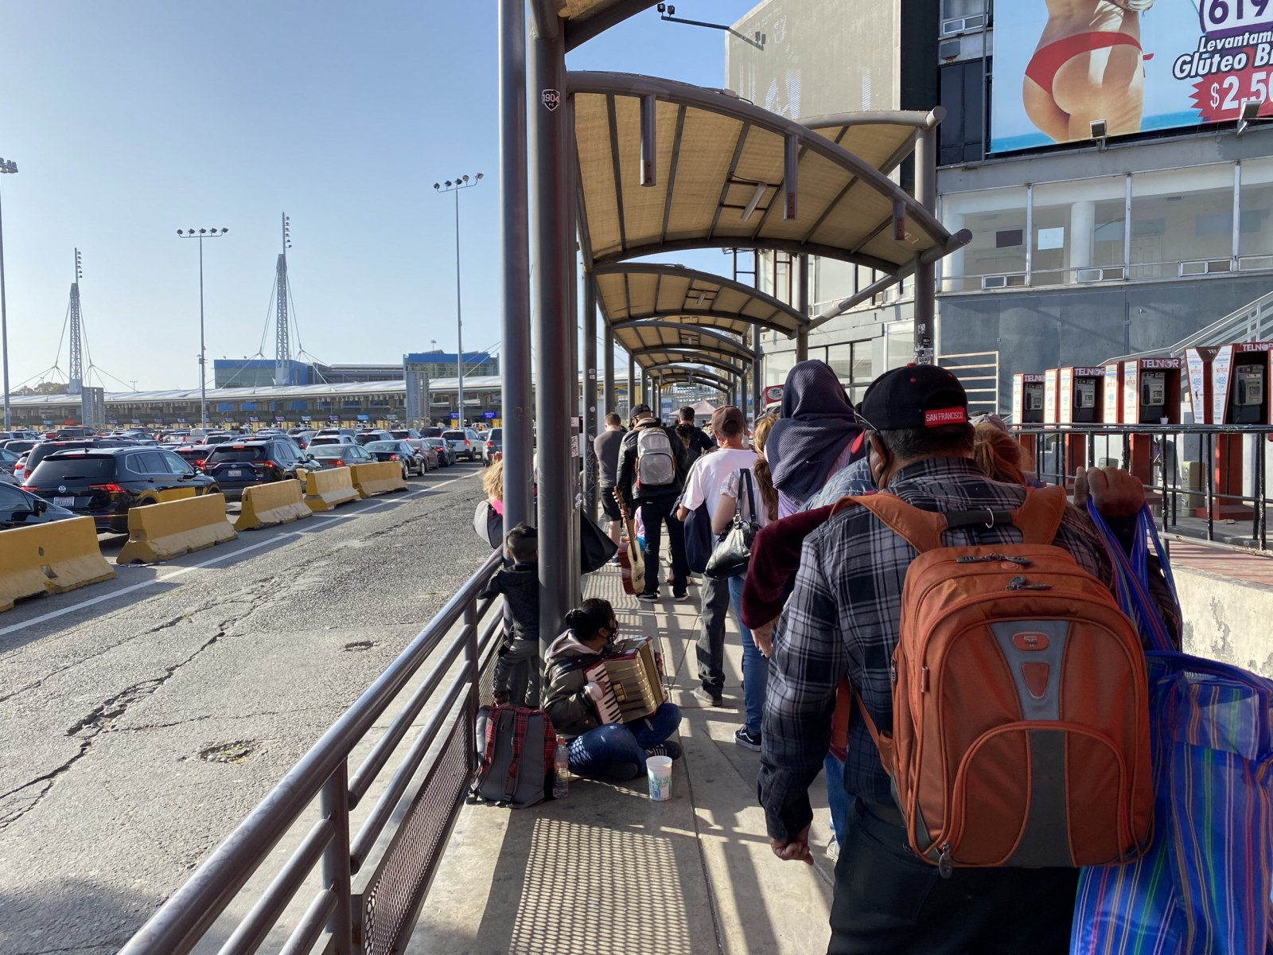
Value Proposition
20,000 northbound pedestrians at San Ysidro Port of Entry on daily basis
Approximately 60% of these pedestrians are not members of the Trusted Travelers program and therefore frequently experience wait times of 60 minutes+
Potential to redirect approximately 12,000 daily pedestrians

Slide 4
Proposed Solution
XPC Facility
Implementation
New port of entry designed for pedestrians
Situated on parcel of land located just east of San Ysidro POE
Land on US side is owned by US federal government
Land on MX side owned by state of Baja California
Baja state government is financing a feasibility study regarding this facility.
Building used by ADMICARGA could be repurposed for pedestrians
Pedestrian path would connect POE to closest Tijuana light rail station
Additional path would link POE to San Ysidro trolley station on US side

Slide 5
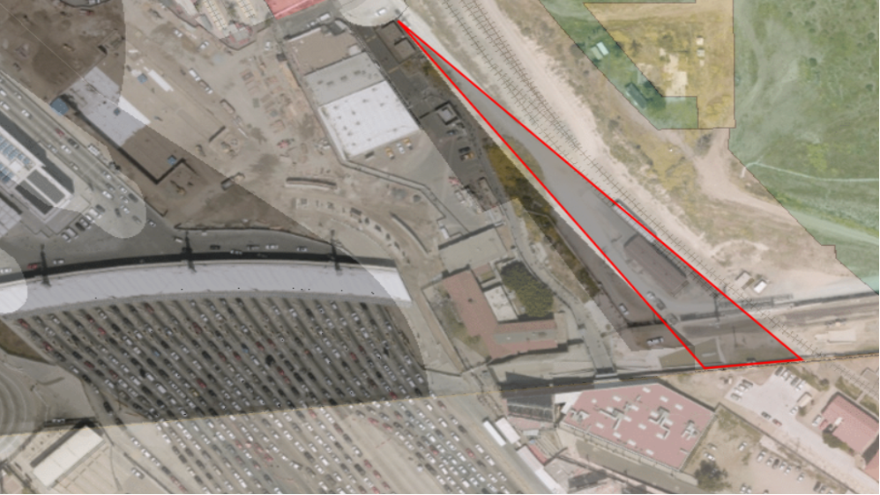

Slide 6
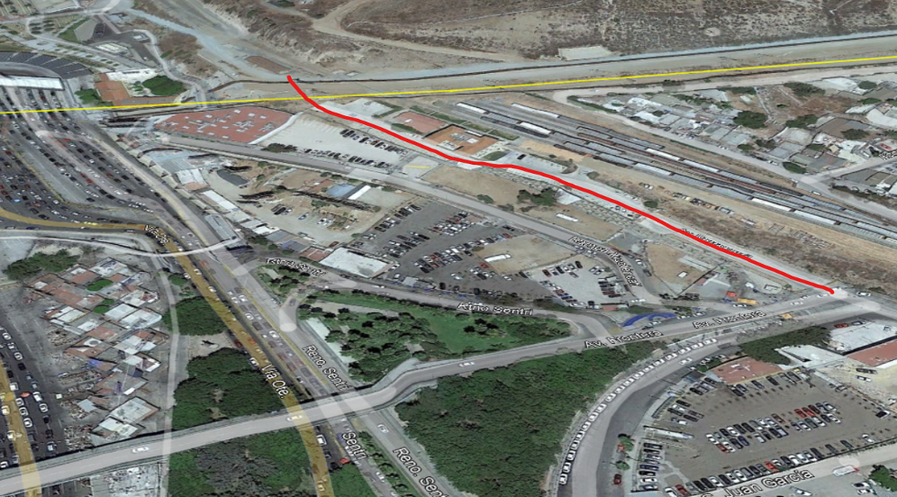

Slide 7
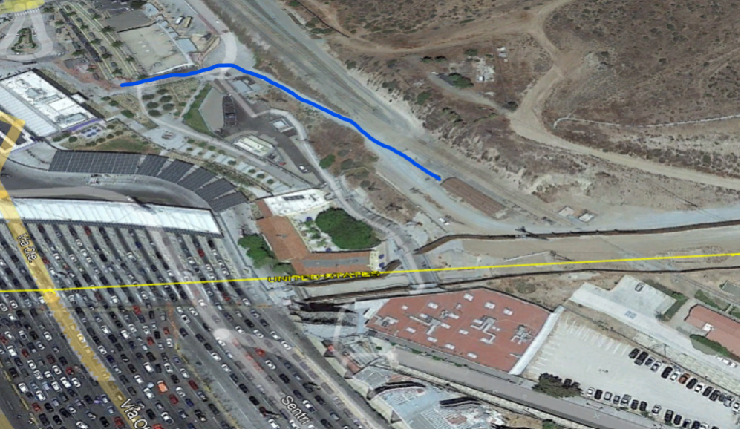

Slide 8
Complementary Proposals
20
22
20
22

Slide 9
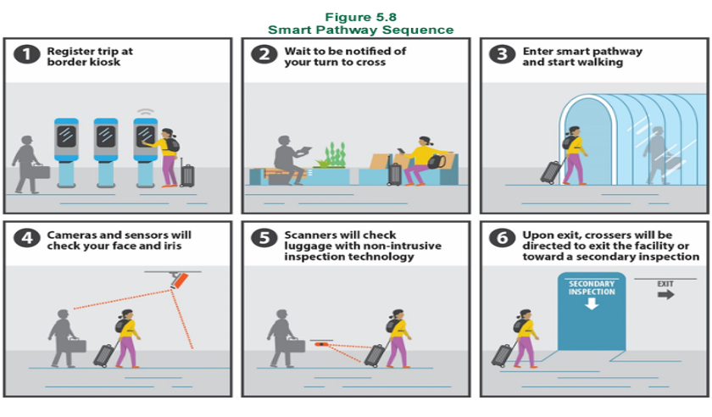
Smart Pathway
01
Modeled after smart tunnel at Dubai international airport
Users register their trip at kiosks
Walk through pathway where users’ biometric information is scanned to verify identity
X-ray scanners will scan luggage while users walk through pathway
Flagged users will be directed to secondary inspection

Slide 10
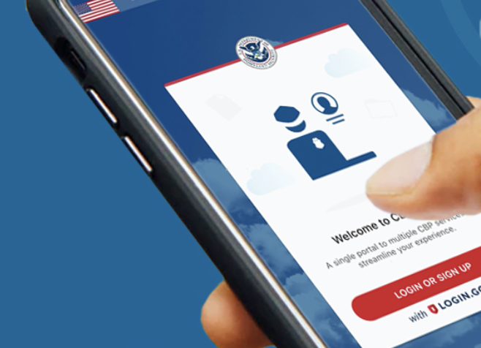
Reservation and Preliminary Verification via CBP One App
02
Expansion of existing technology
Users would make a “reservation” to cross
Documentation would be uploaded prior to crossing
CBP personnel would verify information ahead of time, reducing time spent per pedestrian
Flagged pedestrians would be redirected to secondary inspection

Slide 11
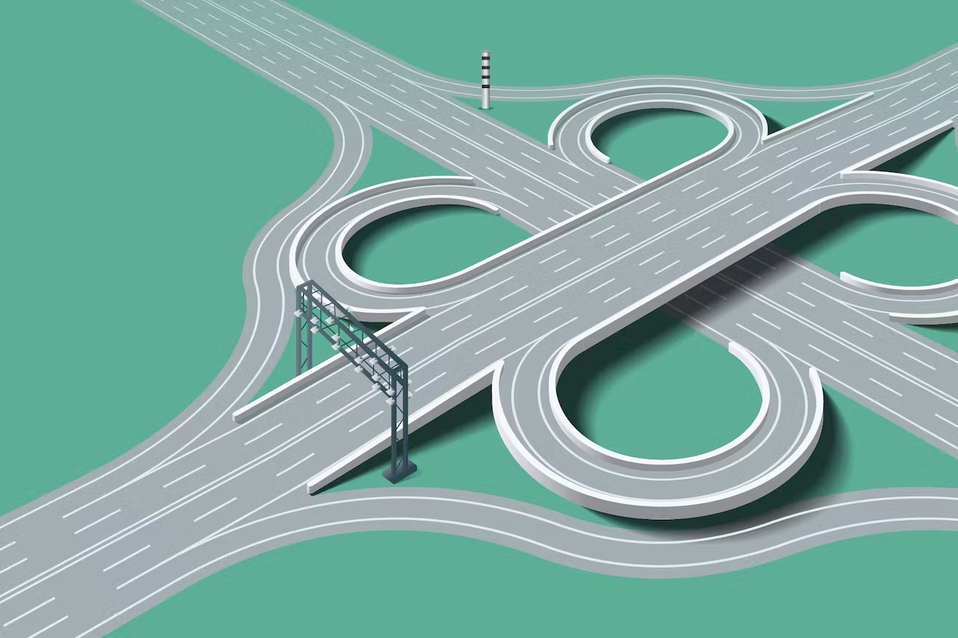
Flexible Toll System
03
Toll would vary depending on traffic volumes of pedwest and pedeast crossings
Live data collection system would monitor traffic levels continuously
App or loadable card would charge toll at processing booth
Recommended that toll is waived for light rail users and cyclists

Slide 12
Funding Mechanisms
20
22
20
22

Slide 13
Funding Mechanisms
Private Funding | Hybrid Funding Model | Federal Funding
Private actors fund construction and operations Negotiate staffing and salaries with CBP. | Public-public model based on Otay Mesa East POE Funded by state and federal agencies After construction facility would be handed over to the General Services Administration as a gift Federal government would manage and fund operations | US federal government would provide 100% of funding Requires congressional authorization for full funding of construction and operations

Slide 14
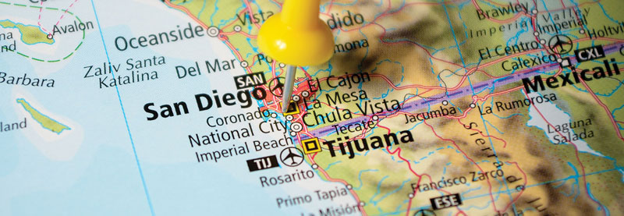
Conclusion and Final Recommendation
Private funding (CBX Model)
Facility only on US side, pedestrian path connecting facility to Puerta México POE on MX side.
Flexible toll system
CBP1 App

Slide 15
Thank you

